Slide 1



Facial Recognition-Based Attendance System
This presentation outlines the implementation of a Facial Recognition-Based Attendance System designed to address challenges in classroom attendance tracking.

Slide 2
Problem Statement
Current Issues
Easy to fake attendance
Takes up valuable class time
Inefficient tracking & reporting

Slide 3
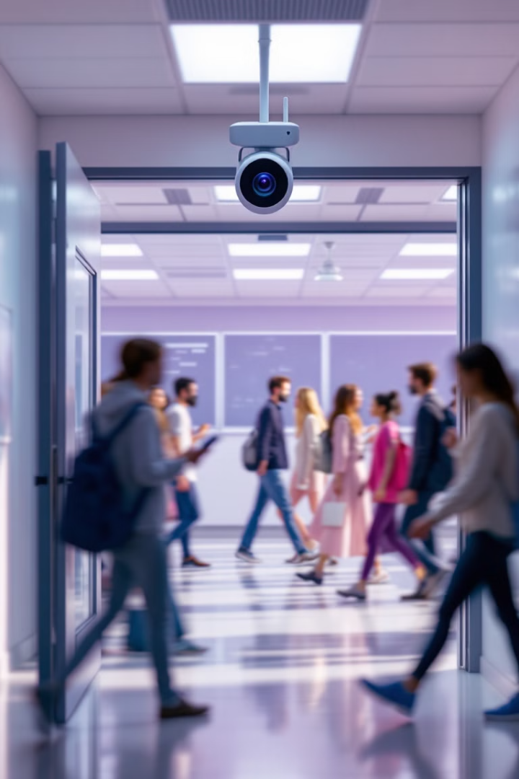
Proposed Solution
Facial Recognition
Lecturer Dashboard
Uses biometric facial recognition for student attendance.
Lecturer initiates attendance sessions and views real-time data.
Automatic Logging
System records attendance, preventing fraud.

Slide 4





Key Features
Student Registration
Facial Recognition
Lecturer Dashboard
AI detects and verifies student faces.
Students upload photos for database training.
Session management, attendance tracking, and reporting.
Admin Module
Manages users, schedules, and system updates.

Slide 5
Development Approach
Requirement Analysis
1
Gather user needs and define technical requirements.
2
System Design
Plan architecture, database, and UI wireframes.
Implementation
3
Develop front-end, back-end, and AI model.
4
Testing
Verify system functionality and security.
Deployment & Maintenance
5
Deploy the system, monitor performance, and update AI models.

Slide 6





How the System Works
Registration Phase
Students provide facial data for system training.
Attendance Session Start
Lecturer initiates session via dashboard.
Recognition Process
Camera scans students' faces upon entry.
Attendance Logging
System marks students as Present or Absent.
Report Generation
Lecturers can view and export attendance data.

Slide 7
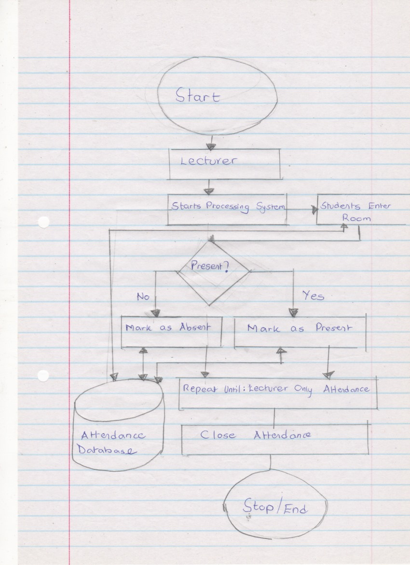
Data Flow Diagram
Start -> process -> end

Slide 8

Benefits of the System
Eliminates Fraud
Prevents students from signing in for others.
Saves Class Time
Reduces time spent taking attendance manually.
Real-time Tracking
Lecturers can monitor attendance throughout the session.
Secure Records
Provides automated and secure attendance records.

Slide 9

Challenges and Considerations
Privacy Concerns
Recognition Accuracy
Implement data encryption and GDPR compliance.
Train AI model with diverse datasets for improved performance.
Hardware Setup
Ensure high-quality cameras and reliable network connectivity.

Slide 10
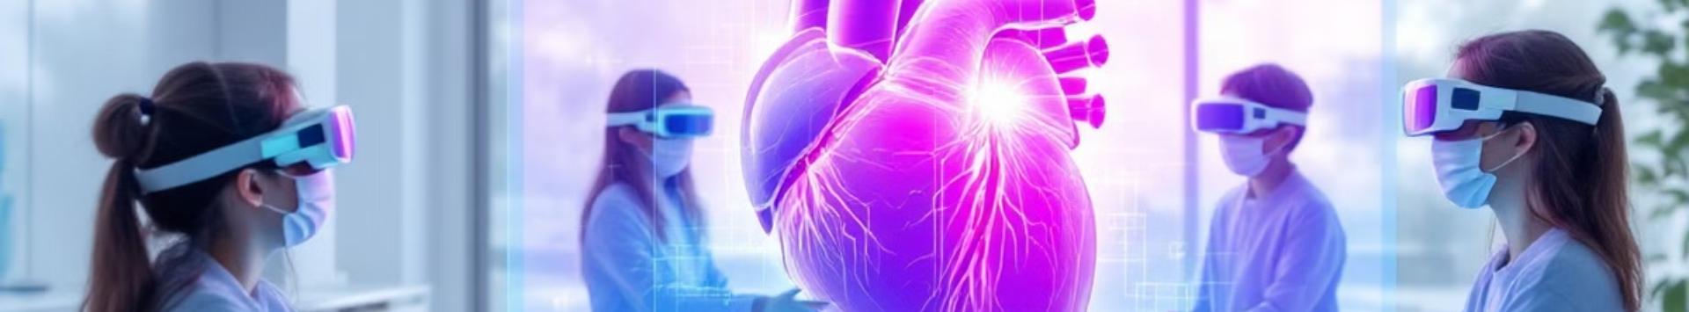
Conclusion
A facial recognition-based attendance system offers a more efficient, secure, and automated solution for classroom attendance tracking.
Future enhancements include mobile app integration, AI-powered performance analytics, and expansion to workplace attendance and event check-ins.

